Slide 1
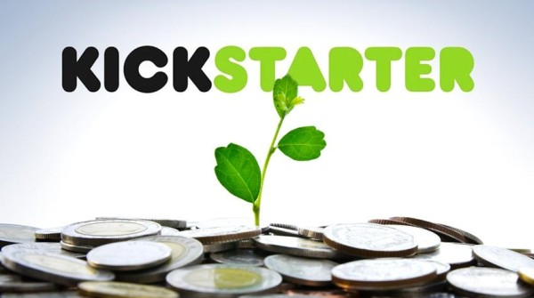
Kickstarter CROWDFUNDING PROJECT
Group 5:
Eruva Ramya,
Gudla Gangothri

Slide 2

INTRODUCTION:
Crowdfunding is the practice of funding a project or venture by raising small amounts of money from a large number of people, typically via the Internet.
Thousands of creative projects are funding on Kickstarter at any given moment. Each project is independently created and crafted by the person behind it.
The filmmakers, musicians, artists, and designers you see on Kickstarter have complete control and responsibility over their projects

Slide 3
Challenges & Potential solutions
Challenges
Potential Solutions
Build trust with clear and honest information
Set realistic and achievable funding goals
Provide regular updates to backers
Poor project visibility
Unrealistic funding goals
Limited marketing reach

Slide 4

Steps Taken to sOLve the problem
1.Data Understanding :
2. Data Cleaning :
Reviewed Crowdfunding dataset fields (Creator, Location, Calendar Table, category, currency etc.)
Removed duplicates, handled null values

Slide 5

5. Projects Overview KPI : Total Number of Projects based on outcome Total Number of Projects based on Locations Total Number of Projects based on Category Total Number of Projects created by Year , Quarter , Month 6. Successful Projects Amount Raised Number of Backers Avg Number of Days for successful projects
3. Convert & Build:
Converting the Date fields to Natural Time
Build a Calendar Table using the Date Column Created Date ( Which has Dates from Minimum Dates and Maximum Dates) & Adding columns
4. Data modelling:
Building the data model by using the attached files
5. Convert the Amounts:
Convert the Goal amount into USD using the Static USD Rate.

Slide 6
6. Dashboard Optimization : Applied filters, tooltips, and drill-through Ensured clean layout and consistent color theme
Key Dates
7. Validation :
Cross-checked values with source data and tested slicer interactions.

Slide 7
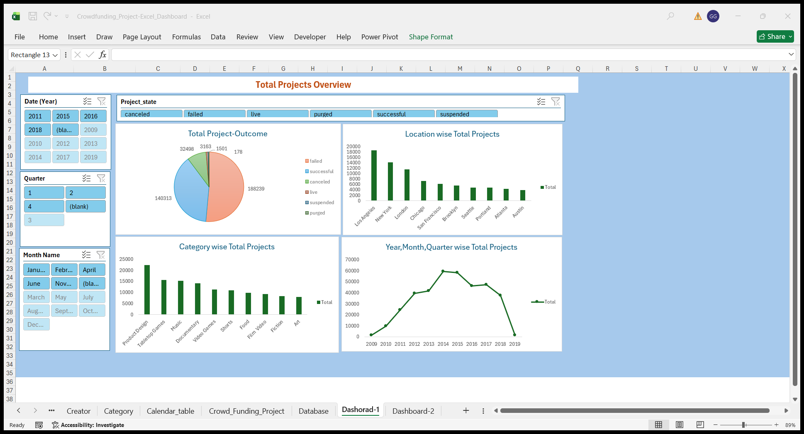
Excel Dashboard

Slide 8
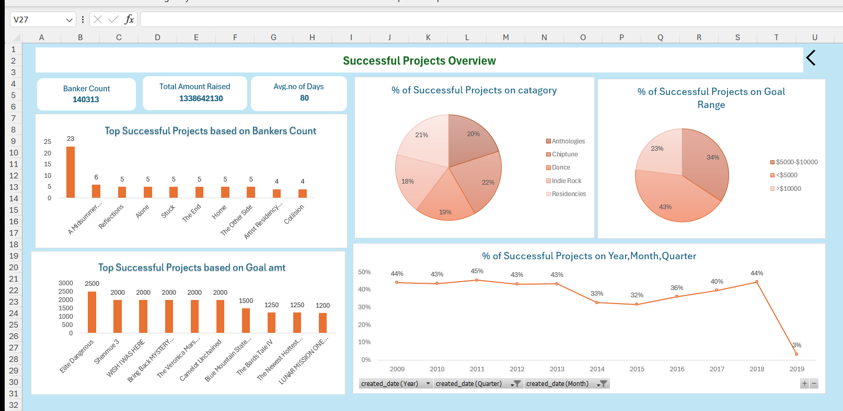

Slide 9
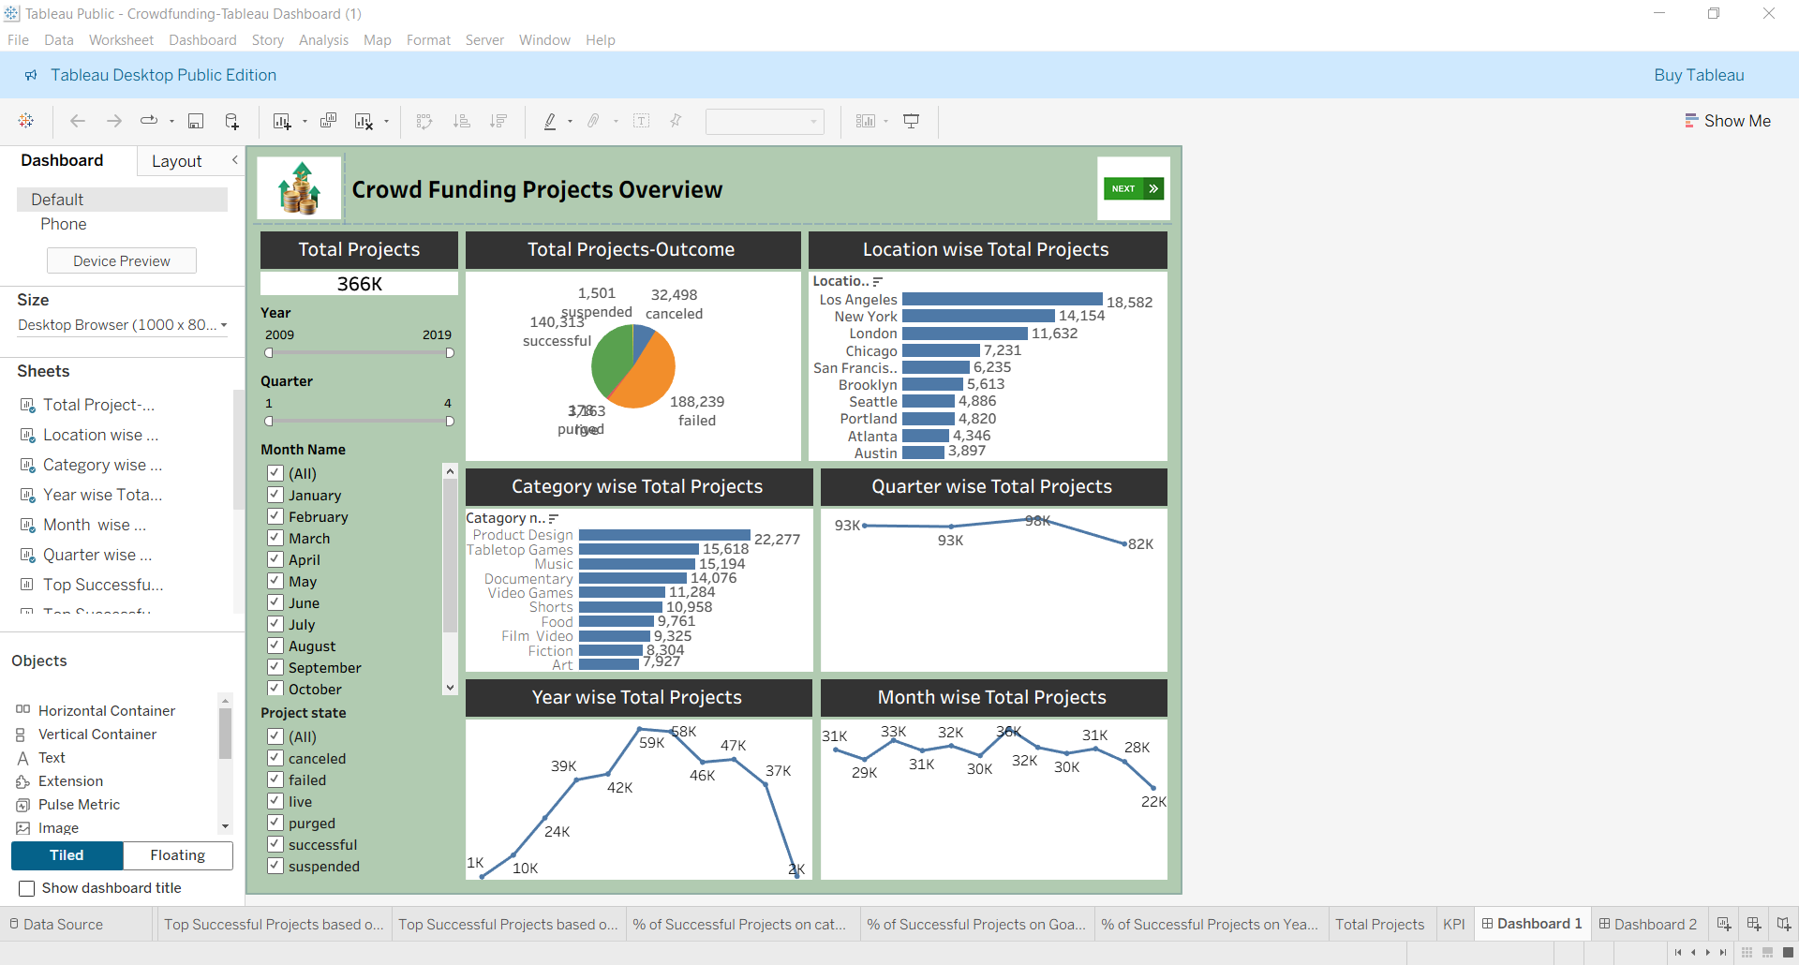
Tableau dashboard

Slide 10
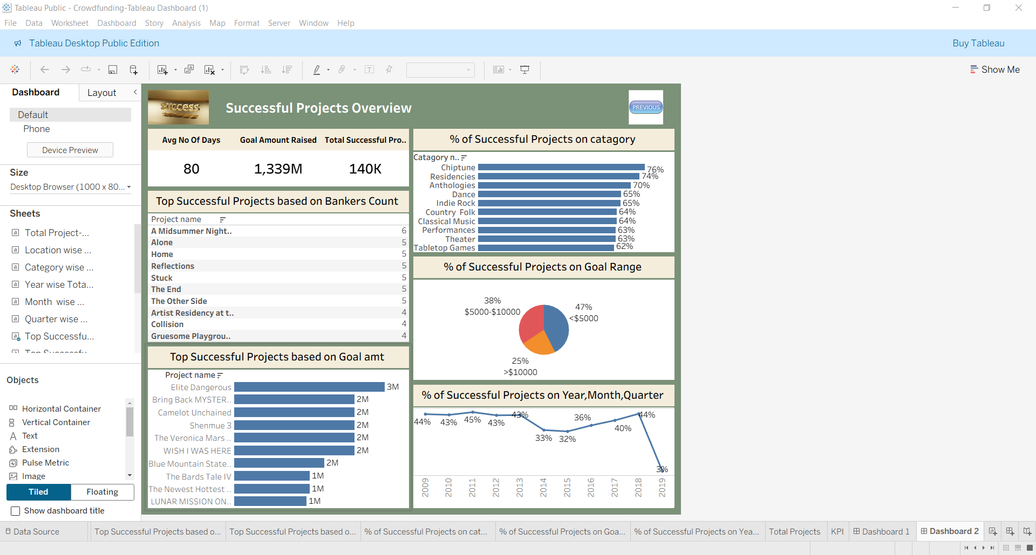

Slide 11
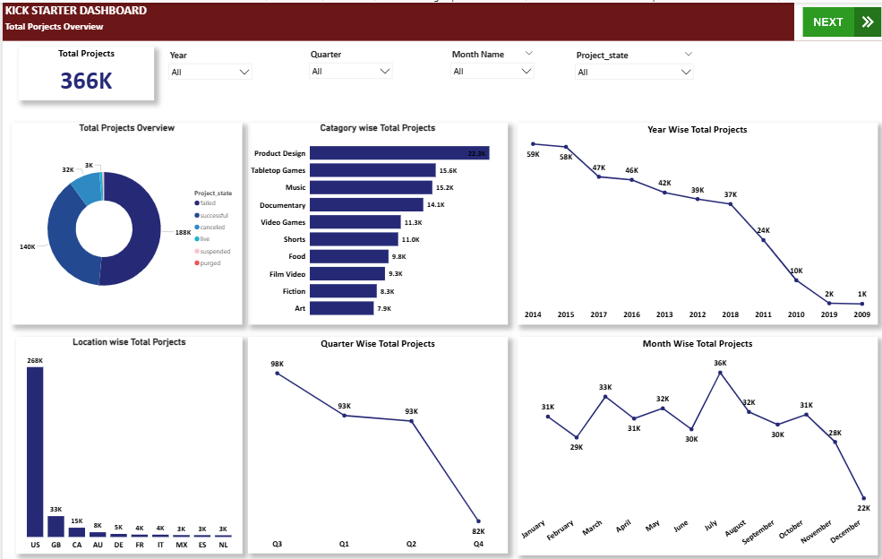
Power BI Dashboard

Slide 12
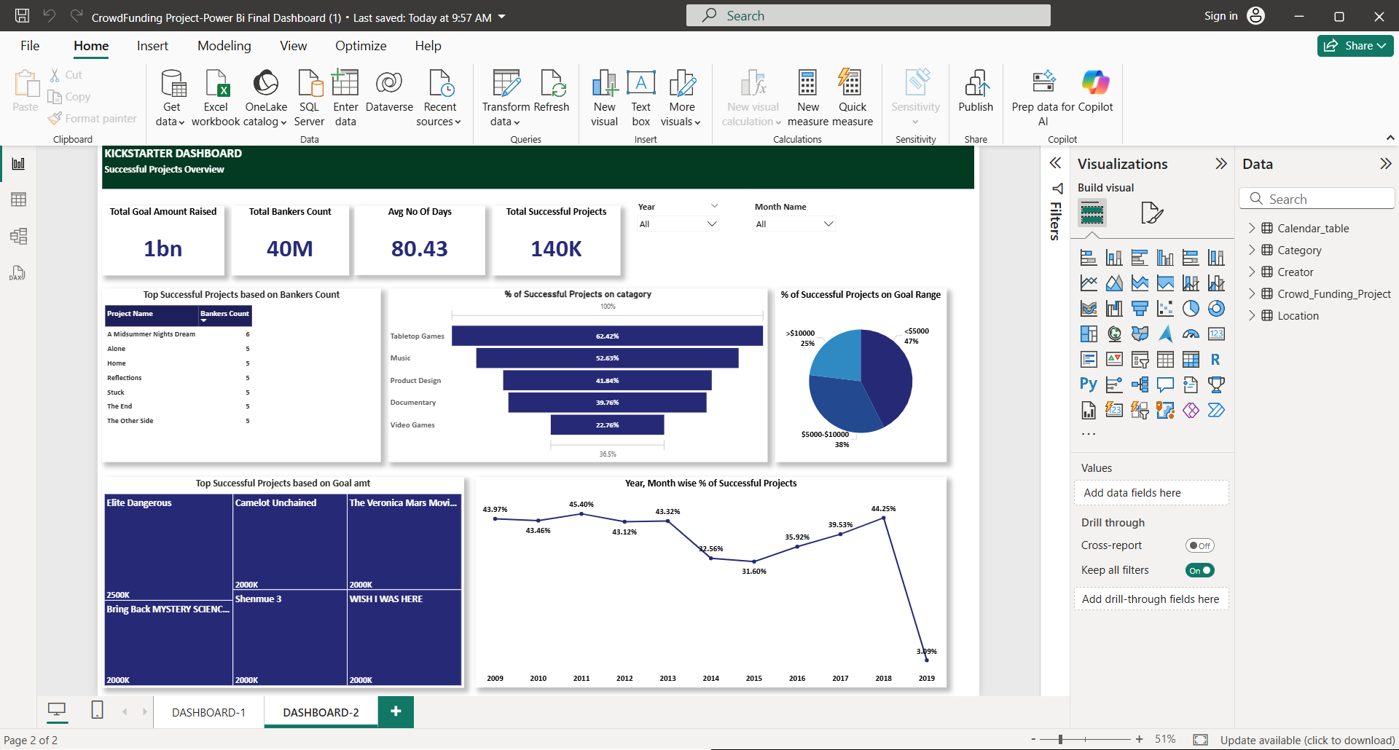

Slide 13
conclusion
Crowdfunding on Kickstarter enables creators to raise funds by connecting directly with supporters online. Despite challenges like poor visibility, unrealistic goals, and limited marketing reach, these can be overcome with transparency and consistent updates.
Data cleaning, modeling, and conversion of values into USD helped in building accurate insights. Dashboards in Excel, Tableau, and Power BI provided KPIs such as project outcomes, funding amounts, and backer engagement.
Filters, tooltips, and drill-through features ensured dashboards were optimized and user-friendly. Validation steps confirmed accuracy and reliability of the data presented.
Overall, combining data-driven analysis with clear communication improves project success rates. This approach highlights the importance of trust, planning, and visualization in crowdfunding success.

Slide 14
Thankyou

